Slide 1
SSW Device management
Design guide

Slide 2
SSW Device management
Design guide
Version 1,4

Slide 3

Setup and configure device management with Intune and Office 365 in Sogeti Smart Workspace

Slide 4
Classic vs Modern Workspace Management

Slide 5
Classic versus Modern Workspace Management
Classic IT
Modern IT
Single Device
Business Owned
Corporate Network & Legacy Apps
Manual
Reactive
High-touch
Multiple Devices
User and Business Owned
Cloud Managed &
SaaS Apps
Automated
Proactive
Self-Service
vs

Slide 6
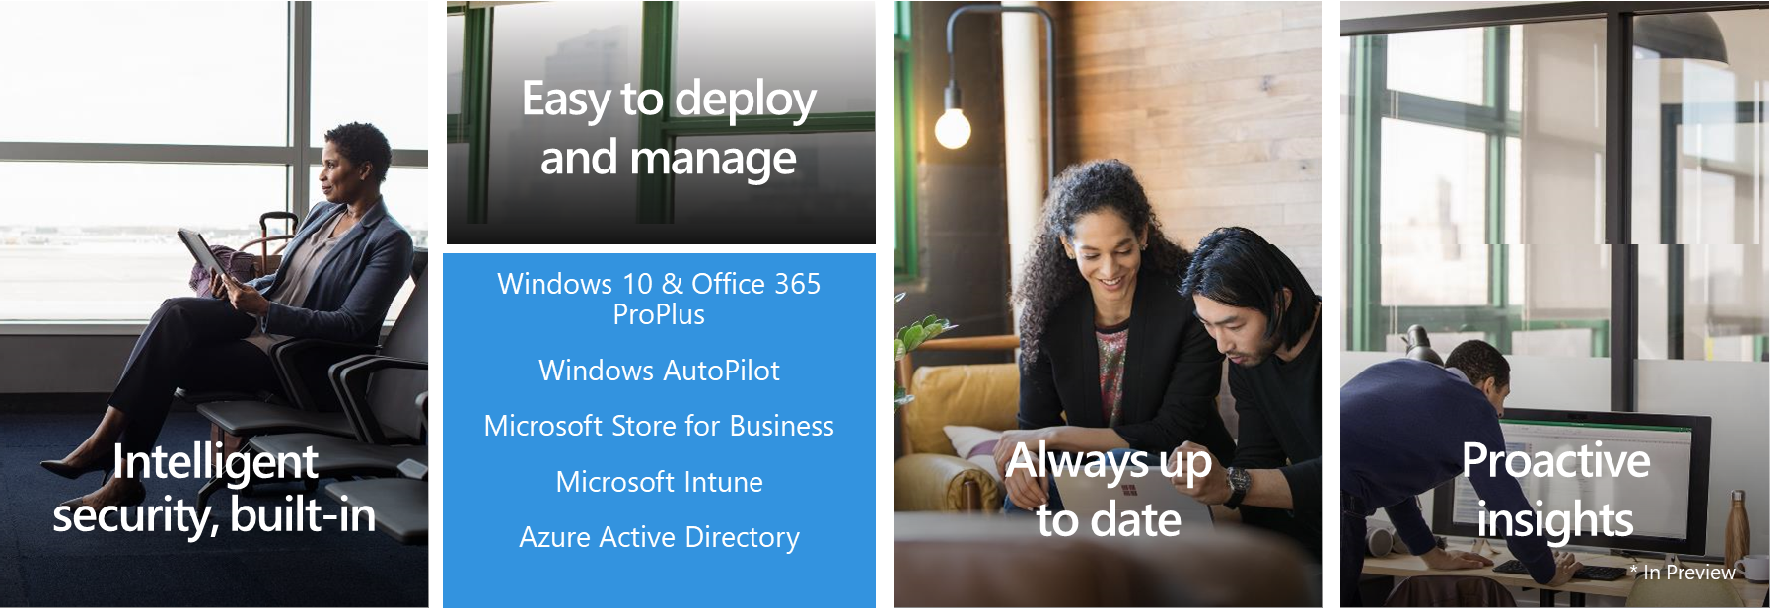
Microsoft 365 Powered device
SSW

Slide 7
Windows 10 onboarding & deployment

Slide 8
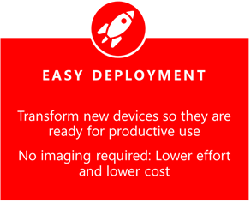
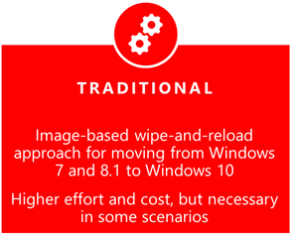
Windows 10 device onboarding & deployment
User Driven
IT Driven

Slide 9

User driven deployment with Autopilot

Slide 10
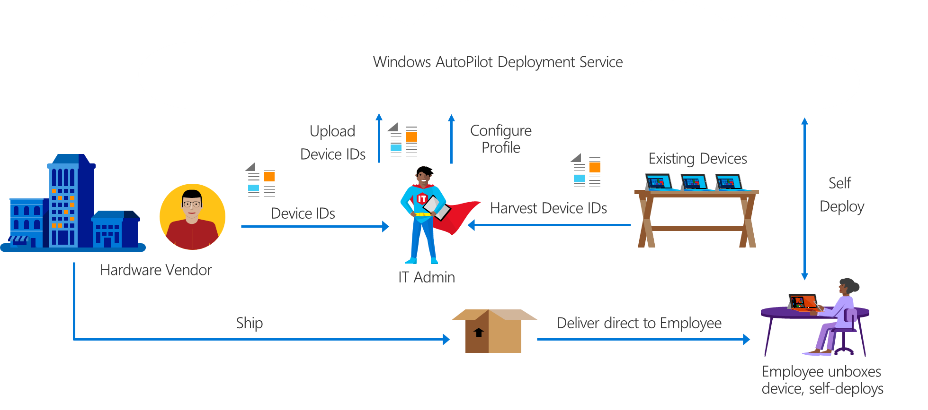
Autopilot Process

Slide 11
Autopilot device registration
Devices must be pre-registered before onboarding
For new devices, this can be arranged by and through the vendor
For other devices, already in use by the customer or not supported by vendor, the device must be registered at the Autopilot service using the device-id. The device-id’s are gathered (harvested) from the devices using a PowerShell script and then uploaded to the Autopilot service.
A Device profile is configured in Intune (or Windows Store for Business)
Experience for users (skip EULA for instance)
Add users as Local Administrators or as Standard User (SSW default)
White glove deployment

Slide 12
Autopilot for existing devices
Only suitable for existing devices when already equiped with Windows 10
During the process, a reinstallation of Windows 10 is initiated using the built-in reset service
As an alternative, Windows 10 can be deployed to existing devices using an image and MDT (see IT driven deployment). From here, there are 2 options:
Automatic deployment stops at the OOBE phase. The device-id must be harvested during this deployment step. When the device is re-started, the Autopilot onboarding process is initiated. The deployment is more complex but does not require a provisioning package for AAD join with a bulk token that expires every month.
The Autopilot profile is injected during OS deployment, the profile is picked up during the OOBE phase

Slide 13
IT Driven deployment with Imaging and MDT
Modern imaging process
Thin image deployment
Scripted imaging with dism and/or built with ‘Windows Image Builder’ – SSW Custom tool for image creation & Management
Applications are installed and config is applied during deployment and/or via Intune
Device is joined to AAD and enrolled in Intune during deployment
Image is deployed with MDT
May require additional deployment infra on prem (WDS/PXE)
Deploy with USB drives: no infra required (except for a standalone machine with the MDT console and deployment share)

Slide 14
Deployment guide: User vs IT driven
User Driven deployment scenario when:
Customer is using new devices to onboard in SSW or existing devices can be registered for Autopilot
Users can be in control of their ‘personal’ (but still company owned) device
IT Driven deployment scenario when:
Devices must be redeployed, for example when existing devices are transformed to SSW managed devices and/or do not have Windows 10 yet
Customer requires the use of a custom image
Standard device has or needs a rich set of applications
User driven deployment is the preferred method

Slide 15
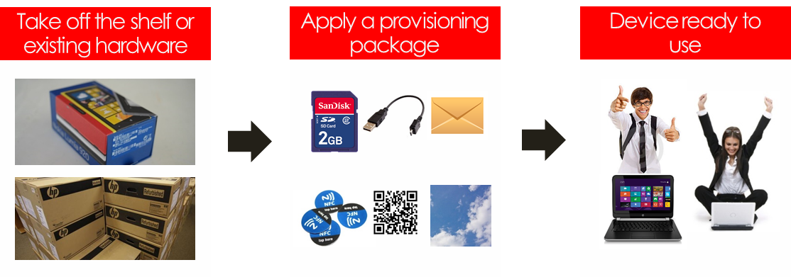
Alternative 1: Provisioning packages

Slide 16
Alternative 1: Provisioning packages
Use provisioning packages when:
Existing devices are re-used for SSW
Devices are already deployed with Windows 10
Re-deploy devices and onboard with Autopilot are not an option – for whatever reason
Only small customization is required

Slide 17
Alternative 2: Hybrid join
Devices with the Windows 10 Fall Creators update can be joined to AD and AAD simultaniously in the so called Hybrid joined scenario. Users log in to the device with their AD account but, since the device is AAD hybrid joined, also have SSO to services that use Azure Active Directory. You can consider this alternative scenario when:
User accounts are synchronized from AD to AAD using AAD Connect (password hash sync for instance);
Users need to access resources (files, printers, applications) in the on-premise (AD-) network directly from their devices. For example when they are in the office network or use a VPN connection;
Devices are managed and/or deployed with traditional tools (AD GPO, SCCM, etc);

Slide 18
Onboaring macOS devices

Slide 19
Deployment options for macOS devices w/Intune
Company owned devices
Apple Business Manager (Device Enrollment Program)*
Apple School Manager
Device Enrollment: full management capabilities
Apple Configurator Setup Assistant enrollment
Apple Configurator direct enrollment
Bring Your Own Devices (BYOD)
Device Enrollment: full management capabilities
User Enrollment: subset of management capabilities
*Needs a reseller entitled to offer Apple Business Manager

Slide 20
Onboaring iOS devices

Slide 21
Deployment options for iOS devices w/Intune
Company owned devices
Apple Business Manager (Device Enrollment Program)*
Apple School Manager
Device Enrollment: full management capabilities
Apple Configurator Setup Assistant enrollment
Apple Configurator direct enrollment
Bring Your Own Devices (BYOD)
Device registration: suitable for personal devices in combination with Mobile Application Management (MAM) without enrollment
Device Enrollment: full management capabilities
User Enrollment: subset of management capabilities
*Needs a reseller entitled to offer Apple Business Manager

Slide 22
Onboaring Android devices

Slide 23
Deployment options for Android devices w/Intune
Device registration: suitable for personal devices in combination with Mobile Application Management (MAM) without enrollment
Android Enterprise enrollment (MDM)
Work Profile: suitable for personal devices creating a separate (encrypted) container for work apps and data. Can be combined with MAM
Dedicated device: suitable for functional /kiosk devices
Enterprise full management: suitable for company owned devices
Device Administrator Enrollment (MDM)
Use an enrollment account to enroll devices (deprecated)

Slide 24
Enterprise Fully Managed devices - Enrollment
Near Field Communication (NFC) Android 5.1 and above
Token entry Android 6 and above
QR code Android 7 and above
Zero Touch* Android 8.0
Not all manufacturers
Requires supplier/reseller to be involved in the program

Slide 25
Device Management with Intune: configuration guide

Slide 26
Device Management with Intune
Enrollment: MDM, WIP and MAM
Compliance & Configuration policies
Windows Updates: device life cycle
Conditional Access
Security Baselines for Windows 10
Note: While Intune is a SaaS service, we speak of configuration rather than design.

Slide 27
Manage devices: MDM or WIP/MAM
With Intune, management can be configured at device level (MDM) or at application level (MAM);
MDM supports Windows, macOS, iOS and Android.
MAM is supported for iOS, Android and Windows 10.
For Windows 10, MAM is based on Windows Information Protection (WIP) which can be used on devices with Windows 10 Creators Update (1703) or newer installed, incl. W10 Home;
Differentiation occurs at device ownership (Company/CYOD or BYOD) and platform (Windows, iOS, Android, macOS or other)

Slide 28
Management of Windows devices
In SSW, we make the following default choices for Windows devices:
Corporate Windows 10 devices are AAD joined and MDM enrolled. This enables compliance policies and conditional access.
User owned Windows 10 devices, optionally can be enrolled into MDM by the user to become compliant (requires W10 Pro).
Other devices with Windows cannot be enrolled into Intune and/or are non-compliant by default. This is because not all versions support MDM enrollment in Intune or do not support WIP.
MAM policies for Windows 10 without enrollment are not used because we cannot force the use of other devices than Windows 10 without conditional access. Enrollment is required to determine compliance.

Slide 29
Management of non-Windows devices
Corporate owned non-Windows devices are optionally managed with Intune. These devices need to be enrolled in MDM to enable management and/or compliancy. The requirement to manage non-Windows devices is gathered during the onboarding phase.
Access to corporate data is permitted from devices with iOS or Android without the need to enroll these (user owned) devices in MDM. MAM without enrollment is used instead, to enable protection at application level.
Devices other than Windows, iOS, Android or macOS are non-managed/non-trusted by default as these cannot be enrolled in MDM or controlled with MAM.

Slide 30
Mobile Device Management (MDM)
Automatic enrollment in MDM is configured in AAD upon Azure Active Directory Domain join for Windows 10 devices. In a hybrid scenario (AAD Hybrid join) the same is achieved with a GPO or Autopilot. These options are typical for company owned devices.
Devices can also be enrolled in MDM without joining AAD. This is the case in a BYOD scenario (Azure AD registered). This however gives limited functionality.
Note that enrollement in MDM is not the same as enrolling by installing the Intune Client (the traditional way to use Intune). For a comparisson, see https://docs.microsoft.com/en-us/intune-classic/deploy-use/pc-management-comparison

Slide 31
Enrollment: MDM
After enrollment, the device is under control of Intune from which the following settings are configured on the device:
Configuration policies (depending on the OS and version)
Compliance policies
Application -deployment, -configuration and -protection policies
Software update policies (Windows 10 and iOS)
Security Baseline
Note that while Windows 8.1 is a supported device for enrollment in Intune MDM, in SSW (by default) we do not consider this as a supported OS as not all required features are available for Windows 8.1. With that, some features are only available for Windows 10 Anniversary (1607) or later versions. Because of this, Windows 10 Fall Creators update (1709) or newer is supported in SSW Device Management.

Slide 32
MDM: Configuration guide
Configuration policies
Only required settings are configured
Preferrably applied to Company owned devices only
Compliance policies
Required for conditional access
Next to security requirements, company device fleet determines the required settings
Platform specific policies are used
By default, conditional access is enabled in SSW which also means compliancy policies must be configured

Slide 33
Application policies (MDM and MAM)
Application deployment
Applications can be deployed to devices with Windows 10, iOS, Android and macOS
In MDM, not all package types can be used (https://docs.microsoft.com/en-us/intune/apps-add)
Apps can be deployed to both MDM managed and MAM controlled devices which are not enrolled in MDM
Apps can be required (forced install) on MDM managed devices and optional (‘available’) on both MDM and MAM managed devices

Slide 34
Application policies (MDM and MAM)
Application Configuration policies
These policies are available for iOS and Android only.
Configuration settings are determined in the Application Packaging process during the application intake.
These policies are custom, not part of the standard service.

Slide 35
Application policies (MDM and MAM)
Application Protection policies
These policies protect data that is processed in applications under management of these policies. When applied, data can only be processed by one of the managed apps. Additionally, security meassures are configured in the protection settings.
MAM without enrollement is configured for all available apps on iOS and Android devices
MAM with MDM enrollement (WIP) is configured for all available apps on Windows 10 devices. LOB apps that are WIP-unaware (not enlightened app) are added as custom protected apps.

Slide 36
Software Updates (MDM)
Quality and Feature updates for Windows 10 are deployed using Windows Update for Business. To control update behaviour, Software Update policies are configured.
At least One update ring is configured per servicing channel. Depending on the organization size and complexity, multiple rings with different settings are configured per channel.

Slide 37
Security Baseline (Windows 10 MDM)
Pre-configured groups of Windows settings that help apply a known group of settings and default values that are recommended by the relevant security teams
Requires Windows 10 1809 or later
The baseline settings match those set by GPO for ‘standard’ Windows security teams
Additional baselines for ATP and Edge

Slide 38
Protection with EM+S

Slide 39
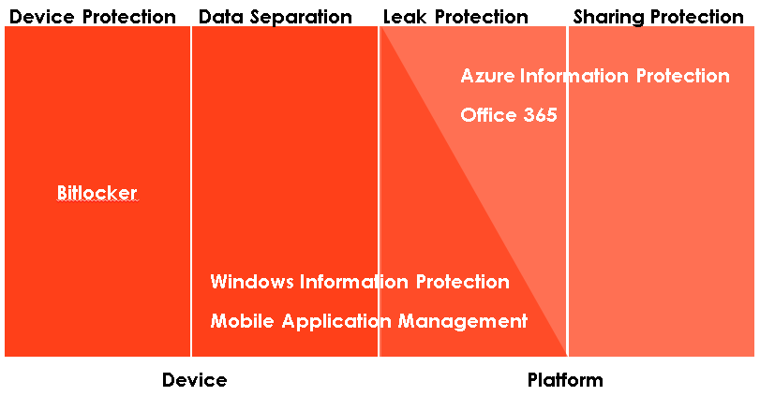
Balance between protection on the device and protection on the information – or combined

Slide 40
Protection of applications and data with EM+S
The combination of Office 365, Intune and Azure Active Directory enables us to configure policies to control and restrict access to applications and data. Depending on the required meassures, different layers of controls are available:
Protection with subscription, username and password
Conditional access with Multi factor authentication
Conditional Access with Device and/or App compliancy
Cloud App Security (available in EM+S E5)
The figure on the following pages explain the different layers of protection and how they are used in SSW.

Slide 41
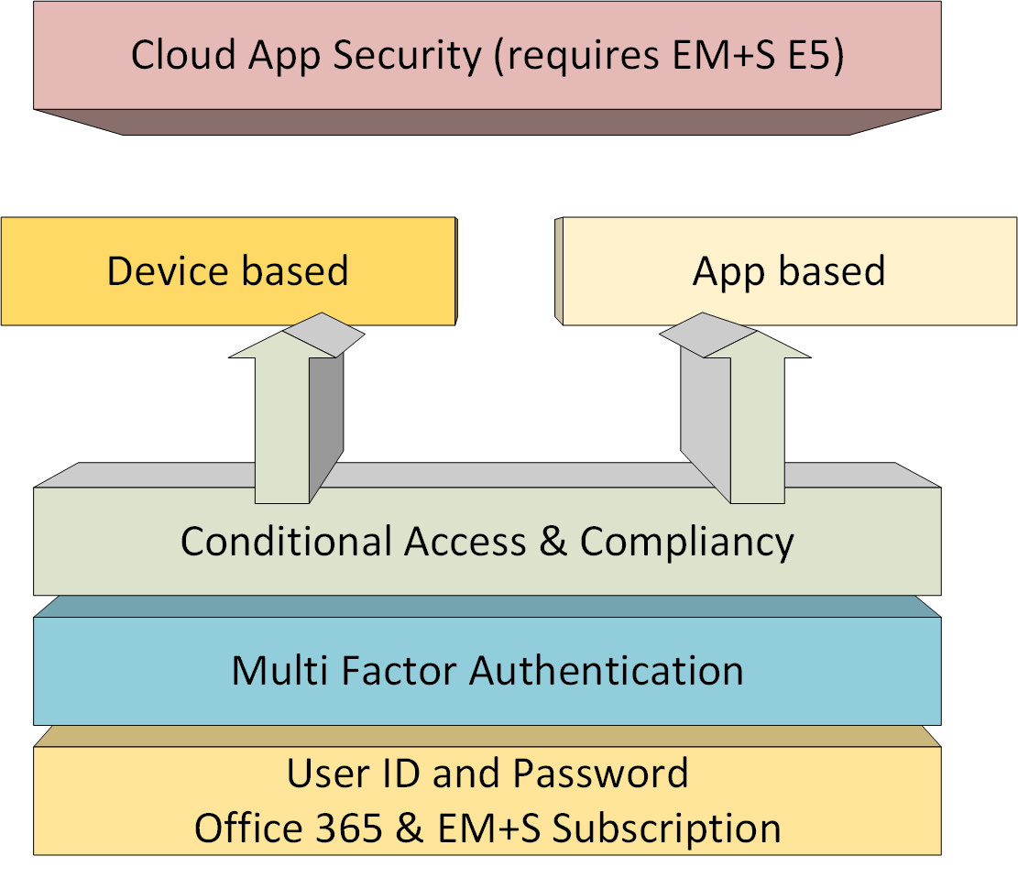
Protection with EM+S: the SSW approach

Slide 42
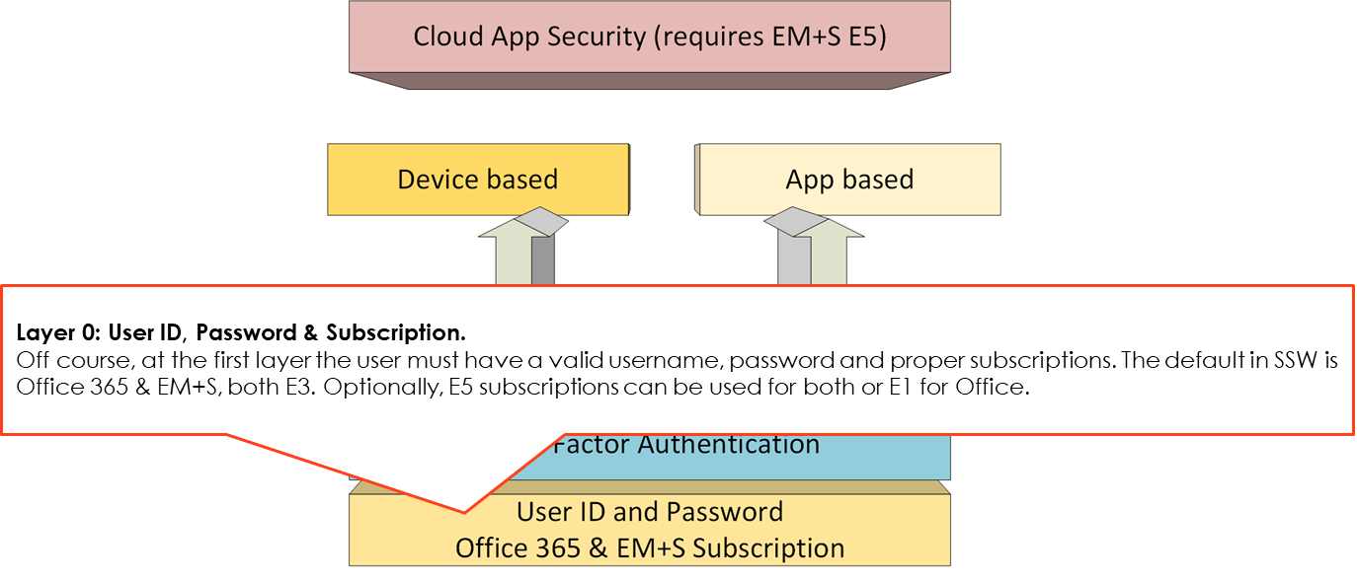
Protection with EM+S: the SSW approach

Slide 43
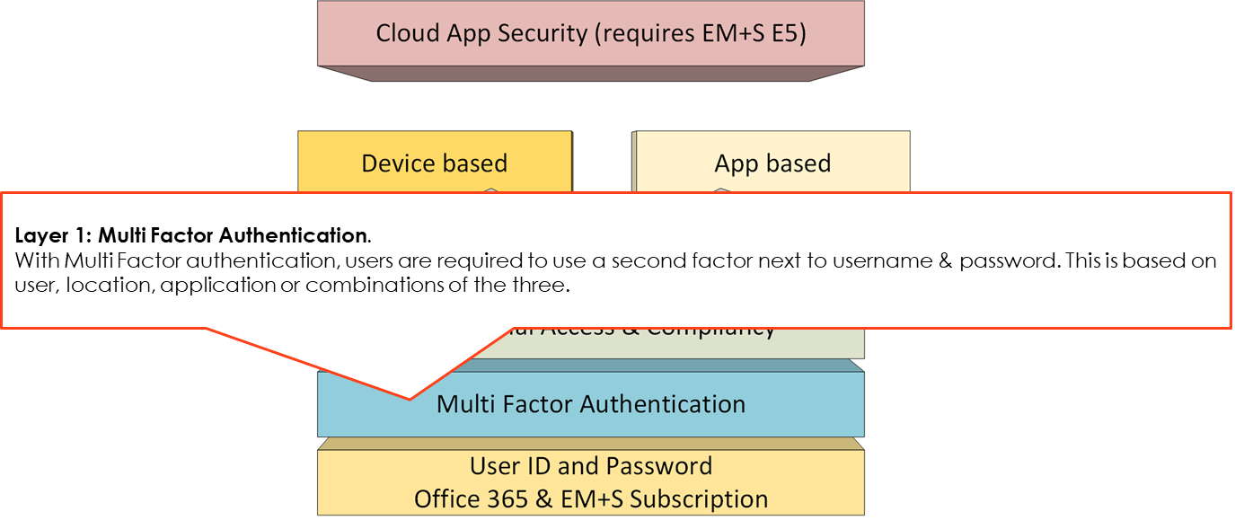
Protection with EM+S: the SSW approach

Slide 44
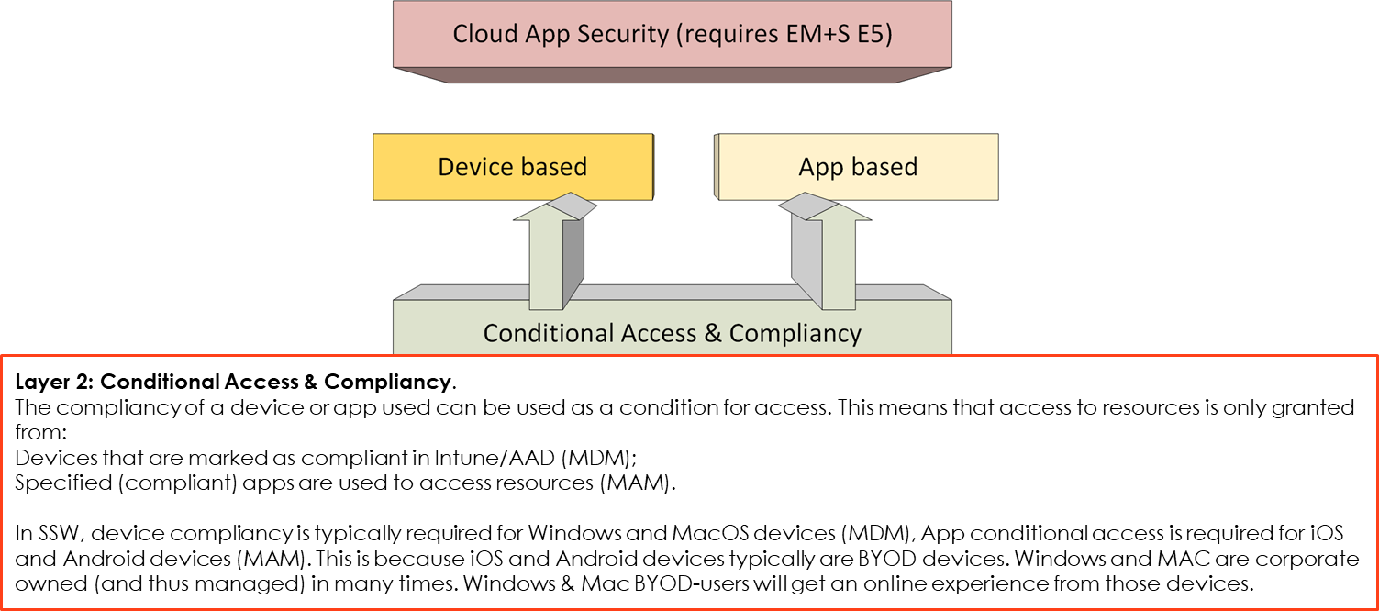
Protection with EM+S: the SSW approach

Slide 45
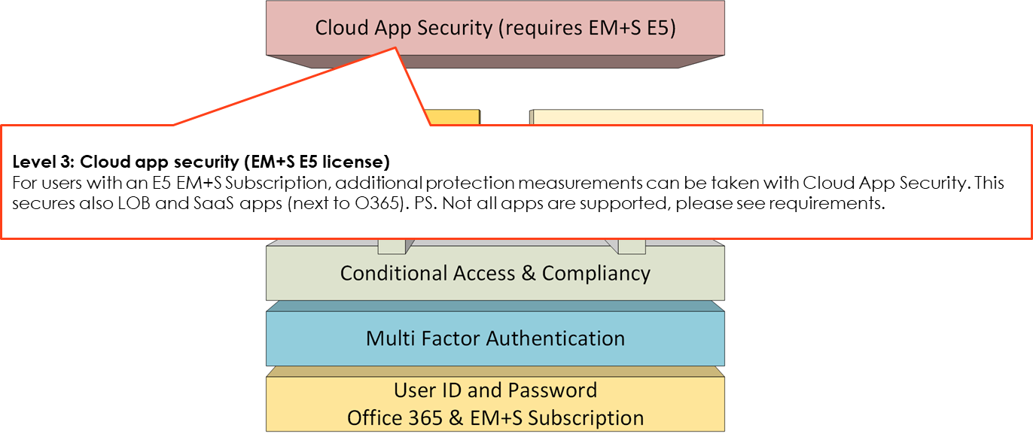
Protection with EM+S: the SSW approach

Slide 46
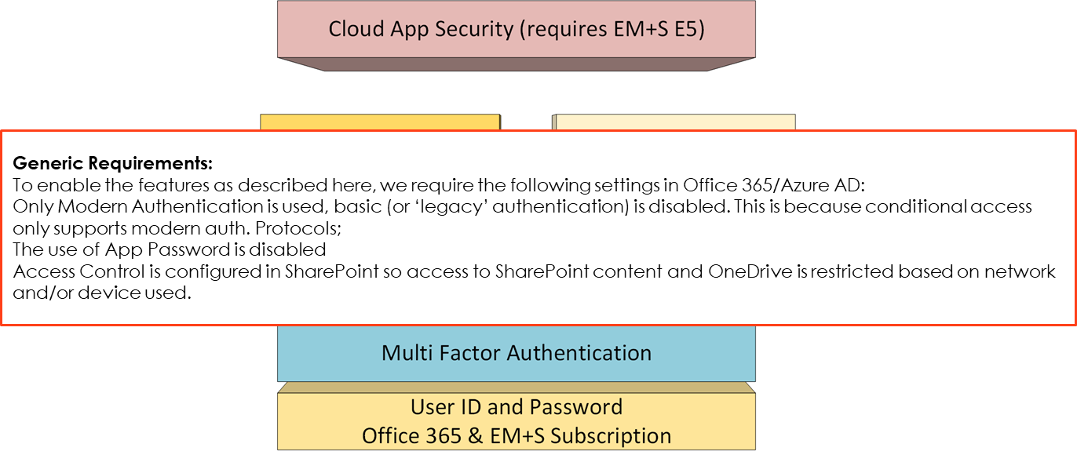
Protection with EM+S: the SSW approach

